Slide 1
Information Security Essentials
Week 7 – Lecture 15,
02-11-2021
Presented by: Syed Yawar Abbas Zaidi

Slide 2
Another case study
Read the following incident and try to find which security breach/breaches occurred, and what can go wrong.
"In early February, a hotel franchise management company that manages 168 hotels in 21 states suffered a data breach that exposed hundreds of guests’ debit and credit cards information in 2013.
White Lodging Services Corporation maintains hotel franchises for some of the top names in lodging such as Hilton, Marriott, Westin and Sheraton. Sources reported that the data breach centered mainly around the gift shops and restaurants within these hotels managed by White Lodging, not necessarily the front desk computers where guests pay for their rooms”.
[http://www.forbes.com/sites/moneybuilder/2015/01/13/the-big-data-breaches-of-2014/]

Slide 3

Finding about the case studies
There are hundreds and hundreds of security breaches accruing around us.
All companies, organizations and individual needs to be vigilant.
Security must be deployed at multiple levels

Slide 4
Security needs and objectives
Authentication (who is the person, server, software etc.)
Authorization (what is that person allowed to do)
Privacy (controlling one’s personal information)
Anonymity (remaining unidentified to others)
Non-repudiation (user can’t deny having taken an action)
Audit (having traces of actions in separate systems/places)

Slide 5
Safety vs. security
Safety is about protecting from accidental risks
road safety
air travel safety
Security is about mitigating risks of dangers caused by intentional, malicious actions
homeland security
airport and aircraft security
information and computer security
Easier to protect against accidental than malicious misuse

Slide 6
Why security is difficult to achieve?
Security in computer systems – even harder:
great complexity
dependency on the Operating System, File System, network, physical access etc.
Software/system security is difficult to measure
function a() is 30% more secure than function b() ?
there are no security metrics
How to test security?
Deadline pressure
Clients don’t demand security
… and can’t sue a vendor

Slide 7
Threat Modeling and Risk Assessment
Threat modeling: what threats will the system face?
what could go wrong?
how could the system be attacked and by whom?
Risk assessment: how much to worry about them?
calculate or estimate potential loss and its likelihood
risk management – reduce both probability and consequences of a security breach

Slide 8
Threat Modeling and Risk Assessment
Secure against what and from whom?
who will be using the application?
what does the user (and the admin) care about?
where will the application run? (on a local system as Administrator/root? An intranet application? As a web service available to the public? On a mobile phone?)
what are you trying to protect and against whom?
Steps to take
Evaluate threats, risks and consequences
Address the threats and mitigate the risks

Slide 9
How much security?
Total security is unachievable
A trade-off: more security often means
higher cost
less convenience / productivity / functionality
Security measures should be as invisible as possible
cannot irritate users or slow down the software (too much)
example: forcing a password change everyday
users will find a workaround, or just stop using it
Choose security level relevant to your needs

Slide 10
Testing Security
Penetration Testing:
Penetration test is a proactive and authorized attempt to evaluate the security of an IT infrastructure by safely attempting to exploit system vulnerabilities, including OS, service and application flaws, improper configurations, and even risky end-user behavior. Such assessments are also useful in validating the efficacy of defensive mechanisms, as well as end-users’ adherence to security policies. –
See more at: http://www.coresecurity.com/penetration-testing-overview#sthash.B23EFh9Z.dpuf

Slide 11



Penetration Testing Tools
Aircrak:
802.11 WEP and WPA-PSK keys cracking program
Angry IP Scanner:
It scans IP addresses and ports as well as has many other features. It is widely used by network administrators
BackBox:
BackBox is an Ubuntu-based distribution developed to perform penetration tests and security assessments for desktop environments
More details on : https://www.concise-courses.com/hacking-tools/

Slide 12
How to get secure?
Protection, detection, reaction
Know your enemy: types of attacks, typical tricks, commonly exploited vulnerabilities
Attackers don’t create security holes and vulnerabilities
they exploit existing ones
Software security:
Two main sources of software security holes: architectural flaws and implementation bugs
Think about security in all phases of software development
Follow standard software development procedures

Slide 13
Protection, detection, reaction
An ounce of prevention is worth a pound of cure
better to protect than to recover
Detection is necessary because total prevention is impossible to achieve
Without some kind of reaction, detection is useless
like a burglar alarm that no-one listens and responds to

Slide 14
Protection, detection, reaction
Each and every of the three elements is very important
Security solutions focus too often on prevention only
(Network/Host) Intrusion Detection Systems – tools for detecting network and system level attacks
For some threats, detection (and therefore reaction) is not possible, so strong protection is crucial
example: eavesdropping on Internet transmission

Slide 15
Is a particular security measure good?
(Questions proposed by Bruce Schneier)
What problem does it solve?
whether it really solves the problem you have
How well does it solve the problem?
will it work as expected?
What new problems does it add?
it adds some for sure
What are the economic and social costs?
cost of implementation, lost functionality or productivity
Given the above, is it worth the costs?

Slide 16
Security through obscurity … ?
Security through obscurity – hiding design or implementation details to gain security:
keeping secret not the key, but the encryption algorithm,
hiding a DB server under a name different from “db”, etc.
The idea doesn’t work
it’s difficult to keep secrets (e.g. source code gets stolen)
if security of a system depends on one secret, then, once it’s no longer a secret, the whole system is compromised
secret algorithms, protocols etc. will not get reviewed → flaws won’t be spotted and fixed → less security
Systems should be secure by design, not by obfuscation
Security AND obscurity

Slide 17
Aspects of Security
Security attack
Any action that compromises the security of information owned by an organization.
Security mechanism
A process that is designed to detect, prevent or recover from a security attack.
Security service
Services that enhances the security of the data processing systems and the information transfers of an organization.
These services are intended to counter security attacks, and they make use of one or more security mechanisms to provide the service.
Notes:
The OSI security architecture focuses on security attacks,mechanisms,and services.

Slide 18
OSI Security Architecture
International Telecommunication Union (ITU-T) recommends X.800, the security architecture for OSI
Defines a systematic way of defining and providing security requirements
Notes:
International telecommunication union (ITU) telecommunication standardization sector (ITU-T)

Slide 19
Security Attacks Classification
Any action that compromises the security of information owned by an organization
Information security is about how to prevent attacks, or failing that, to detect attacks
Classification according to X.800
Passive attack
Active attack
Notes:
A threat is a possible potential danger that might exploit a vulnerability.
Is a sequence of commands that take advantage of a vulnerability in order to cause
vulnerability is applied to a weakness in a system which allows an attacker to violate the integrity of that system.

Slide 20
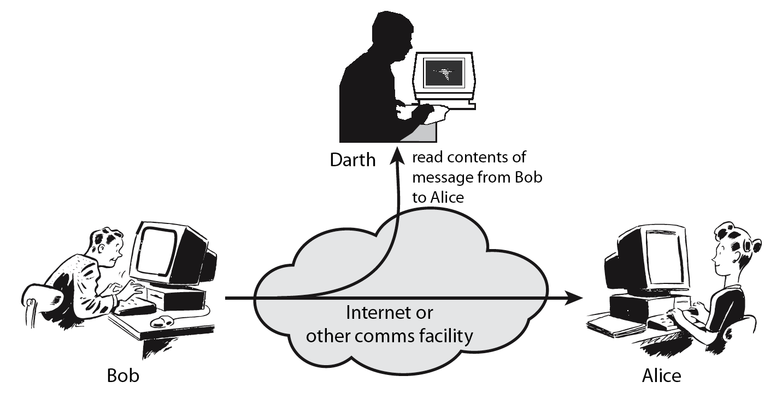
Passive attack
Obtaining message content
Traffic analysis
Notes:
Passive attacks attempt to learn or make use of information from the system but does not affect system resources.
By eavesdropping on, or monitoring of, transmissions to:
+ obtain message contents or
+ monitor traffic flows ( … opponent could determine the frequency and length of messages being exchange this kind of information maybe helpful in determining the nature of communication that was taking place)
Are difficult to detect because they do not involve any alteration of the data.

Slide 21
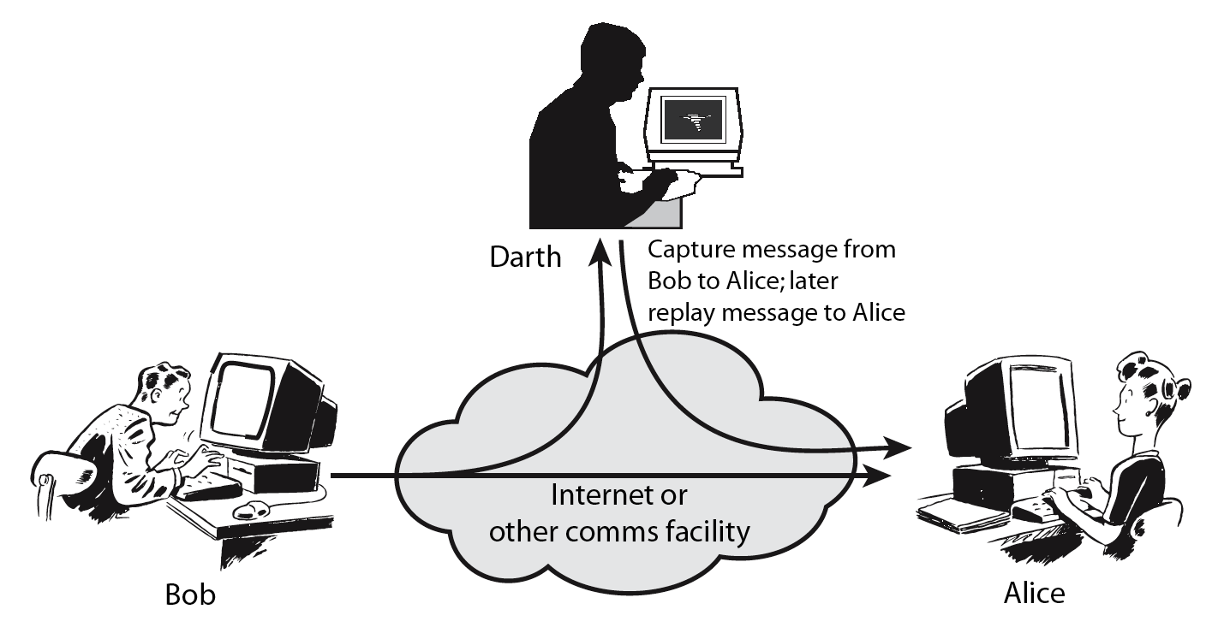
Active attack
Masquerade
Replay previous messages
Modify messages in transit
Denial of service
Notes:
Active attacks attempt to alter system resources or affect their operation.
By modification of data stream to:
+ masquerade of one entity as some other
+ replay previous messages (as shown above in Stallings Figure 1.4b)
+ modify messages in transit
+ denial of service
Active attacks present the opposite characteristics of passive attacks. Whereas passive attacks are difficult to detect, measures are available to prevent their success. On the other hand, it is quite difficult to prevent active attacks absolutely, because of the wide variety of potential physical,software,and network vulnerabilities. Instead, the goal is to detect active attacks and to recover from any disruption or delays caused by them.

Slide 22
Security Service
Enhance security of data processing systems and information transfers of an organization
Intended to counter security attacks
Using one or more security mechanisms
X.800 defines a security service as
“a service provided by a protocol layer of communicating open systems, which ensures adequate security of the systems or of data transfers”

Slide 23
Protection
In one protection model, computer consists of a collection of objects, hardware or software
Each object has a unique name and can be accessed through a well-defined set of operations
Protection problem - ensure that each object is accessed correctly and only by those processes that are allowed to do so

Slide 24
Principles of Protection
Guiding principle – principle of least privilege
Programs, users and systems should be given just enough privileges to perform their tasks
Limits damage if entity has a bug, gets abused
Can be static (during life of system, during life of process)
Or dynamic (changed by process as needed) – domain switching, privilege escalation
“Need to know” a similar concept regarding access to data
Must consider “grain” aspect
Rough-grained privilege management easier, simpler, but least privilege now done in large chunks
Fine-grained management more complex, more overhead, but more protective
File ACL lists, RBAC
Domain can be user, process, procedure

Slide 25
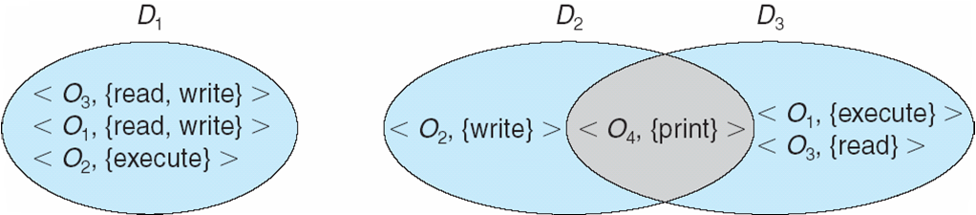
Domain Structure
Access-right = <object-name, rights-set> where rights-set is a subset of all valid operations that can be performed on the object
Domain = set of access-rights

Slide 26
Access control
prevention of the unauthorized use of a resource, that is this service controls
- who can have access to a resource
- under what condition access can occur
- what those accessing are allowed to do

Slide 27
Access Matrix
View protection as a matrix (access matrix)
Rows represent domains
Columns represent objects
Access(i, j) is the set of operations that a process executing in Domain_{i} can invoke on Object_{j}

Slide 28
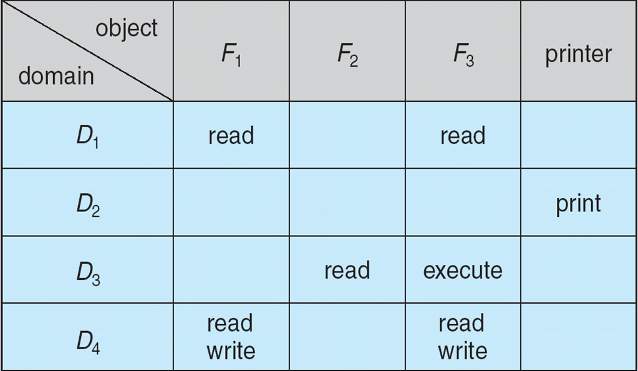
Access Matrix

Slide 29
Use of Access Matrix
If a process in Domain D_{i} tries to do “op” on object O_{j}, then “op” must be in the access matrix
User who creates object can define access column for that object
Can be expanded to dynamic protection
Operations to add, delete access rights
Special access rights:
owner of O_{i}
copy op from O_{i} to O_{j} (denoted by “*”)
control – D_{i} can modify D_{j} access rights
transfer – switch from domain D_{i} to D_{j}
Copy and Owner applicable to an object
Control applicable to domain object

Slide 30
Use of Access Matrix (Cont.)
Access matrix design separates mechanism from policy
Mechanism
Operating system provides access-matrix + rules
If ensures that the matrix is only manipulated by authorized agents and that rules are strictly enforced
Policy
User dictates policy
Who can access what object and in what mode
But doesn’t solve the general confinement problem

Slide 31
Each column = Access-control list for one object Defines who can perform what operation Domain 1 = Read, Write Domain 2 = Read Domain 3 = Read
Each Row = Capability List (like a key) For each domain, what operations allowed on what objects
Object F1 – Read
Object F4 – Read, Write, Execute
Object F5 – Read, Write, Delete, Copy

Slide 32
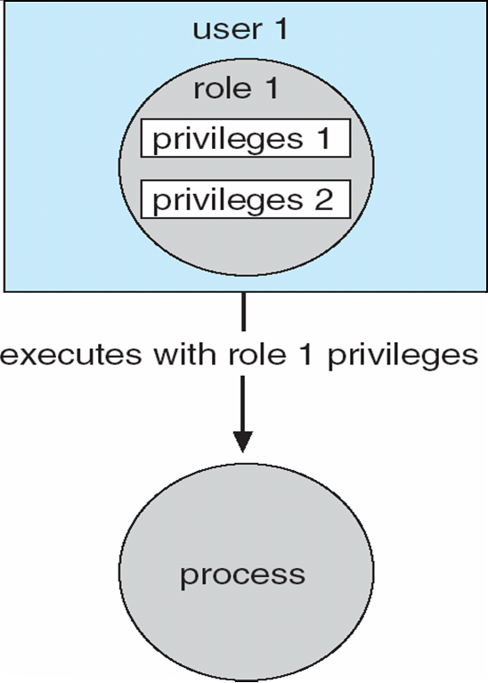
Role-based Access Control in Solaris 10

Slide 33
Summary of today’s lecture
Today we discussed about who the hackers are and what is their motivation
We also discussed the differences between vulnerability and attack.
We continued our discussion on Threat Modelling and Risk Assessment
We have seen that there are security tradeoffs. Too much security can be inconvenient.
And lastly, we discussed about different security testing tools that can be used for penetration testing.

Slide 34
The End

